Slide 1
PPCUG General Meeting
March 20, 2017
Notes:
Over the years, AARP has worked to educate members about how to protect themselves from fraud. State offices have done scam jams and recruited fraud fighters, E&O has produced anti-fraud materials, our publications cover it regularly, and the Foundation runs a Fraud Fighter program that proactively reaches out to people who fit a victim profile to provide them with ammunition to defend themselves. Why has this work continued, even during times when it was not recognized as a high priority of the organization? Because it resonates with our members, and can provide us with opportunities to engage with people who have turned away from us for any number of reasons.
For this reason, we launched the Fraud Watch Network as a pilot campaign. It’s a pretty basic concept:
Identity theft, investment fraud and scams rob millions of Americans of their hard-earned money.
AARP is launching the Fraud Watch Network to give people the resources to spot and avoid ID theft and fraud so they can protect themselves and their families.

Slide 2
Protect Yourself From Identity Theft
Don’t Carry Your Social Security Card
Even exposing the last 4 digits can put you at risk for Fraud
Protect you Medicare Number Too
It’s worth more than Credit Card numbers on the black market
Notes:
READ SLIDE

Slide 3
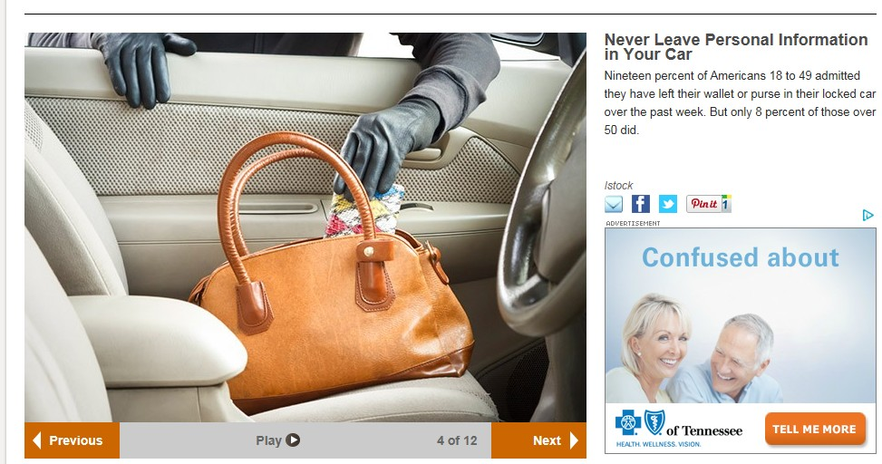
Protect Yourself From Identity Theft
Never Leave Personal Information Visible in Your Car
19 percent of Americans 18 to 49 admitted they have left their wallets or purse in their locked cars recently. Seniors are better with only 8 percent for those over 50 that did.
Notes:
READ SLIDE

Slide 4
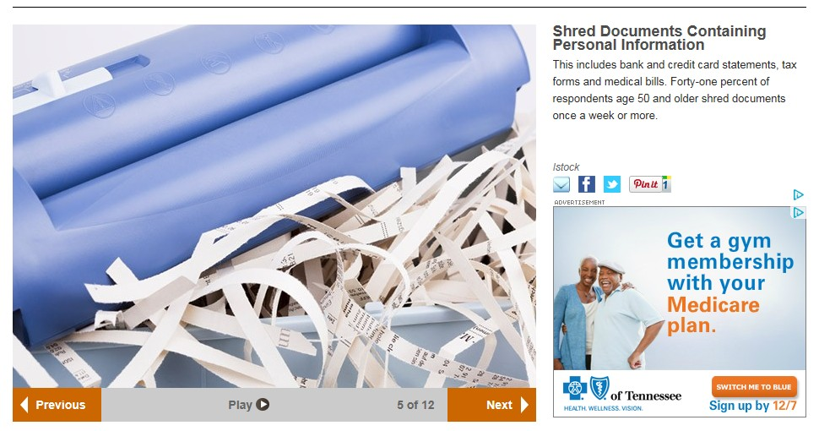
Protect Yourself From Identity Theft
Shred Documents Containing Personal Information
This includes credit card statements, tax forms and medical bills. Only 41% of survey respondents age 50 and older shred documents regularly
Notes:
READ SLIDE

Slide 5
Protect Yourself From Idenity Theft
Monitor Your Account Activity
Check account and credit card statements regularly. Monitor online if you can. 75% Of Americans who bank online say they check their accounts weekly
Notes:
READ SLIDE

Slide 6
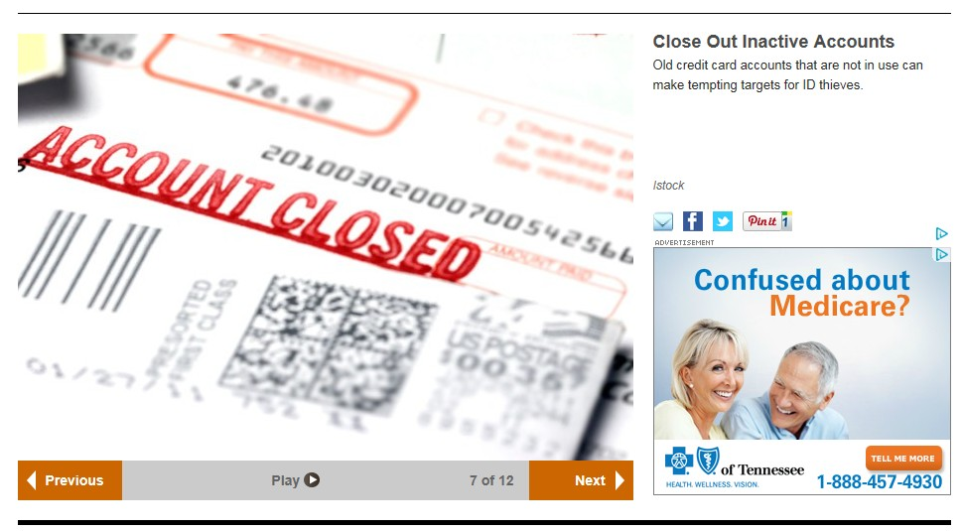
Protect Yourself From Identity Theft
Close out Inactive Accounts
Old credit card accounts that are not being used make tempting targets for ID thieves
Notes:
READ SLIDE

Slide 7
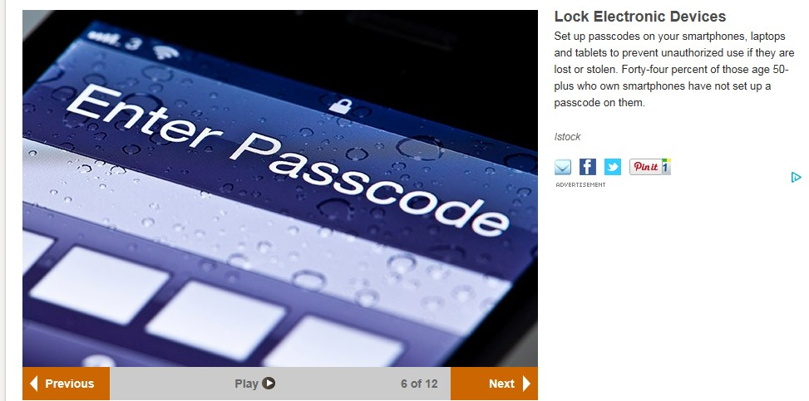
Protect Yourself From Identity Theft
Lock Electronic Devices
Setup passcodes on your smartphones, laptops and tablets to prevent unauthorized use if they are stolen. 44% of survey respondents over age 50 who own smart phones have not set up passcodes
Notes:
READ SLIDE

Slide 8
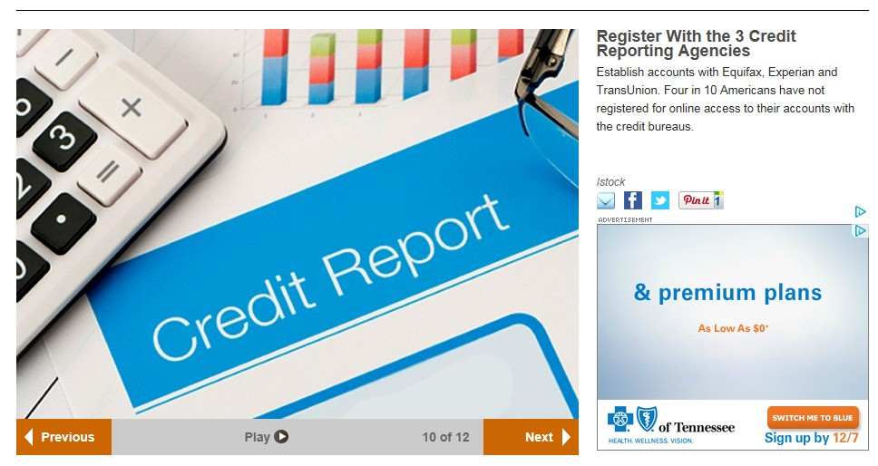
Protect Yourself From Identity Theft
Close out Inactive Accounts
Old credit card accounts that are not being used make tempting targets for ID thieves
Notes:
READ SLIDE

Slide 9
Protect Yourself From Identity Theft
Put Fraud alerts or Freezes on Your Accounts if ID Theft is Suspected
You can put a fraud alert or establish a credit freeze on your accounts by contacting the 3 credit bureaus. Only 16% of survey respondents that had received breach notifications put fraud alerts on their credit files, and less that 6% opted for credit freezes.
Notes:
READ SLIDE

Slide 10
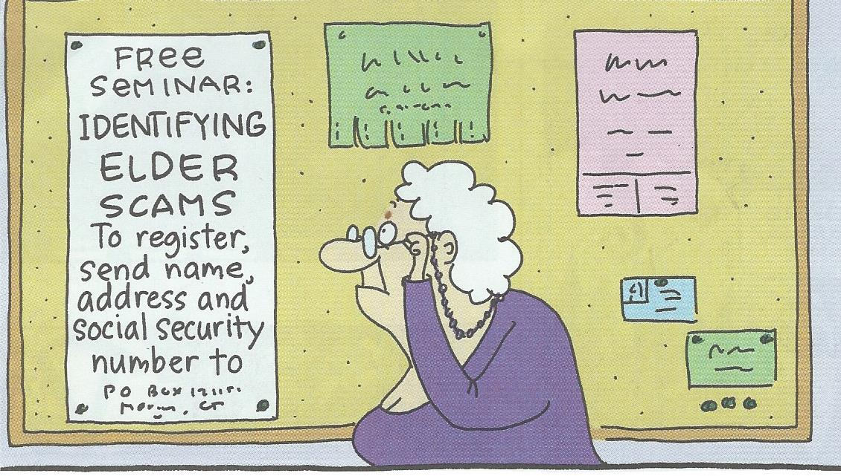
Protect Yourself From Identity Theft
Not a very Good Idea!
Notes:
READ SLIDE

Slide 11
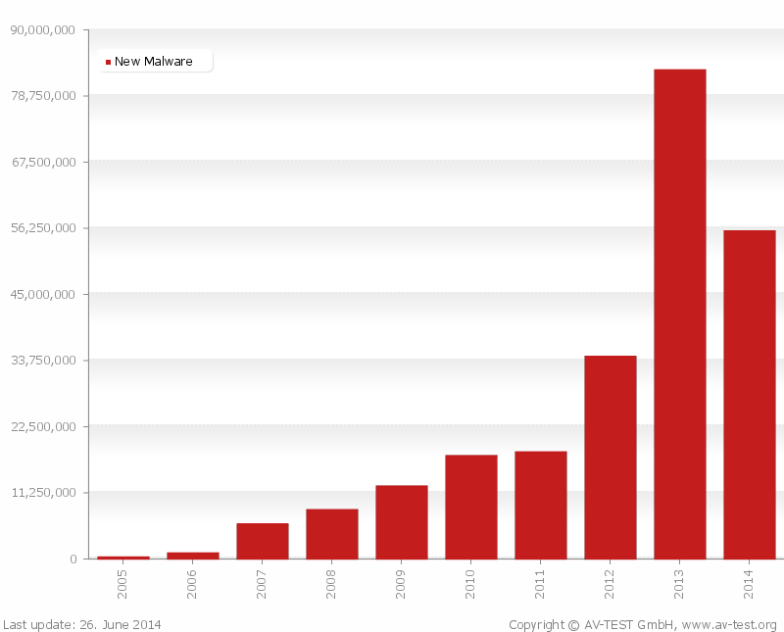
Protect Your Computer
The Rising Malware Threat
Notes:
READ SLIDE

Slide 12
Protect Your Computer
What is Malware?
Malware is an umbrella term used to describe hostile or intrusive software, including:
Trojans, Virus, Worms, Backdoors, Botnets
Phishing account information theft
Bank account withdrawal, credit card usage, loan falsification
RansomWare (You pay to unlock your files)
Keyloggers (copies and transmits your key strokes)
Notes:
READ SLIDE

Slide 13
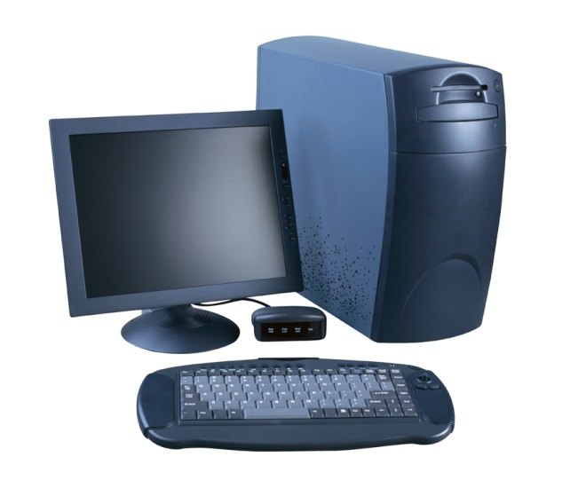
Protect Your Computer
Personal Computers are hacked and subject to viruses and malware just like the government and major corporations.
There are a number of things you can do to protect your personal computer.
Computers and your other mobile devices should use passwords.
If you have a Wireless Network in your home it should be encrypted and require a password to connect. This prevents unauthorized access to your network and is easy to do on your router.
Notes:
READ SLIDE

Slide 14
Protect Your Computer
How to Protect your Wireless Network
Open your Router Setup page
Usually by typing “192.168.1.1” into your web browser, then enter user name and password. Often “admin” for both
Change the default password
Change the Network’s SSID Name
Enable Network Encryption
Enter a passphrase to access your network
For added security you can enable “Filter MAC Addresses”
This limits access to your network to specific devises
Notes:
READ SLIDE

Slide 15
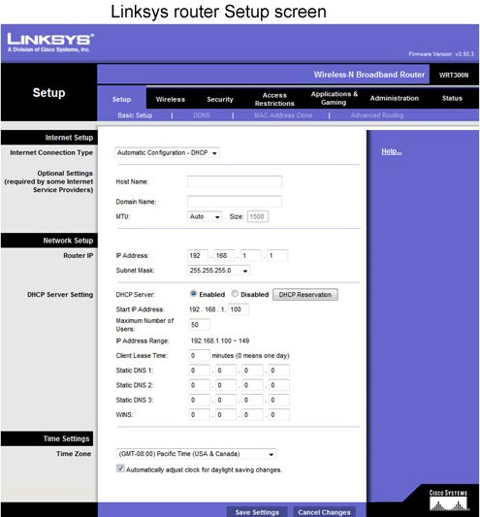
Protect Your Computer
Typical Router Setup Screen
Notes:
READ SLIDE

Slide 16
Protect Your Computer
Connecting to a Secure Wireless Network
Secure Networks require a Passphrase or Key
Most modern Routers have a button on the Router to connect a wireless devise without typing the Passphrase
Notes:
READ SLIDE

Slide 17
Protect Your Computer
Anti-virus and Malware Protection
Computers should have both Virus and Malware Protection Software.
Only one Anti-virus program can be active on your computer.
There can be multiple Malware protection programs running together on your computer.
Most computers have Anti-virus protection but Malware protection is newer and not as commonly used.
Notes:
READ SLIDE

Slide 18
Protect Your Computer
Methods of Infection
Email attachments
Email web links
Infected web sites
Infected Flash drives
Adding an infected system to a network (i.e. Windows XP Computers)
Notes:
READ SLIDE

Slide 19
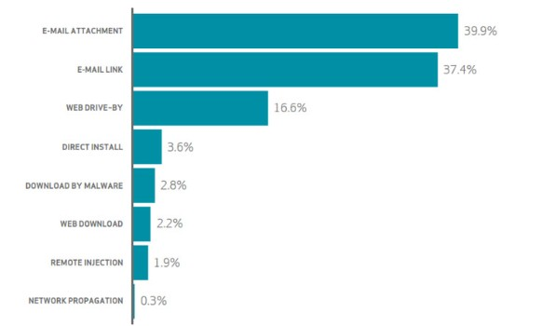
Protect Your Computer
Methods of Malware Infection
Notes:
READ SLIDE

Slide 20
Protect Your Computer
Why “Windows XP” in not Secure
Microsoft and other software companies are constantly providing updates to keep their product secure.
Microsoft’s Windows products have a lifecycle with dates when support ends. Specific dates are as follows:
Windows XP – April 8, 2014
Windows Vista – April 11, 2017
Windows 7 – January, 14, 2020
Windows 8.1 – January 10, 2023
Windows 10 – October 14, 2025
Notes:
READ SLIDE

Slide 21
Protect Your Computer
How to Protect your Computer
Install and keep Antivirus software current and regularly scan your files
Install Malware software like “MalwareBytes”
Run “Windows Update” regularly to keep your operating system current. Periodically run it manually, even if you have it set to update automatically.
Not all updates install automatically, some must be installed manually.
Notes:
READ SLIDE

Slide 22
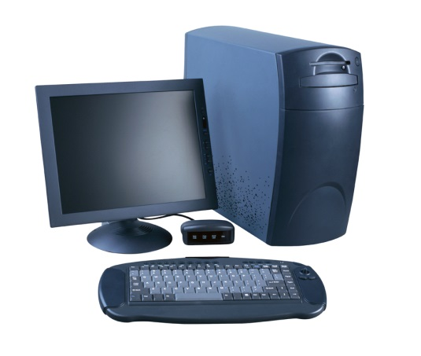
Popular Anti-Malware Software
MalwareBytes
The free version works well but must be run manually to detect and remove suspicious files
The “Pro” version is now a annual subscription for $39.99. It actively runs all of the time. A 14 day Free Trial version is also available.
Notes:
READ SLIDE

Slide 23
Popular Anti-Malware Software
SUPERAntiSpyware Professional
The free version must also be run manually to detect and remove suspicious files.
The “Pro” version has an annual subscription of $25.99 for 1 PC. Free Trial version also available
Additional PCs are $9.95 each.
Notes:
READ SLIDE

Slide 24
Popular Anti-Malware Software
Difficult to Remove Viruses & Malware
Use the Bleeping Computer website for these free downloads. Most popular program include:
AdwCleaner
Junkware Removal Tool
Other Tutorials and Programs
are also available on
Bleeping Computer
Notes:
READ SLIDE

Slide 25
Protect Your Computer
Keep All your Programs Current
Personal Software Inspector (PSI) is a free program that advises you when newer versions are available for the software programs installed on your computer.
It also provides links to download
newer versions as needed.
Notes:
READ SLIDE

Slide 26
Protect Your Computer
Installing or Updating Software
Read the fine print when installing or updating software on your computer before automatically clicking OK .
Sometimes you may be authorizing the installation of additional programs or setting changes that you may not
want.
Notes:
READ SLIDE

Slide 27
Protect Your Computer
Standard verses Admin Accounts
Create and use Standard Accounts rather than Admin Accounts will prevent the installation of new programs on your computer without authorization.
Standard Accounts can do almost everything, but may require a password for tasks like installing new software. Unwanted software won’t be install without authorization.
Notes:
READ SLIDE

Slide 28
Protect Your Computer
Security Sensitive Programs
Oracle's Java is very vulnerable, if you do not need it, remove it for your computer.
Adobe Reader and Adobe Flash Player are vulnerable too, keep them up-to-date with the most current versions
Notes:
READ SLIDE

Slide 29
Protect Your Computer
Don’t Open Suspicious Websites
WOT (Web of Trust) is a free add-on for your browser that warns you of untrustworthy websites and rouge web stores.
It uses a red or green traffic light symbol when searching on the Internet to identify safe and questionable sites
Notes:
READ SLIDE

Slide 30
Protecting Your Idenity
Using your Computer away from Home
WiFi at many hotels, Starbuck’s or MacDonald's without a password is unsecure
Never use unsecured Free WiFi to log into Social Media, engage in Credit Card or online Banking
Public WiFi can come at a steep price – the theft of your finances and identity
Notes:
READ SLIDE

Slide 31
Protecting Your Idenity
Using your Computer away from Home
Rather than using Free WiFi, many Smartphones include a Secure HotSpot for tasks that you want to be secure.
Many SmartPhone plans include the Hotspot feature at no additional change.
Notes:
READ SLIDE

Slide 32
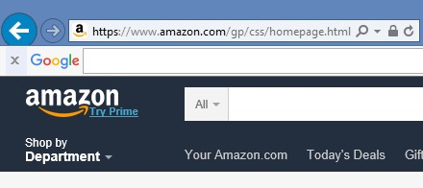
Protecting Your Idenity
How to Identify Secure Websites
Look for the “s” after the “http” in the Website’s (url) address.
This identifies that you are
connected to a secure website.
Notes:
READ SLIDE

Slide 33
Protecting Your Idenity
Using Credit Cards on the Internet
Credit Cards are safe on secure websites with reputable companies.
Limit the number of cards you use online to more easily monitor their use.
Some cards will provide email or text Alerts when….
Card Used in Another Country
Charges Exceed a Specific Amount
that can be as low as $5 or $10.
Notes:
READ SLIDE

Slide 34
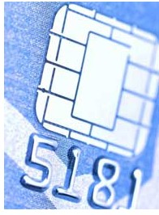
Protecting Your Idenity
Credit Cards with EMV Chips
The new EMV “Smart” Cards can thwart the most common ways thieves clone credit cards.
The chip encodes the information provided the merchant differently each time it is used.
The chip does not provide this protection when used online.
But some cards will provide email or
text Alerts when….
Card Not Presented – Like Online Use
Notes:
READ SLIDE

Slide 35
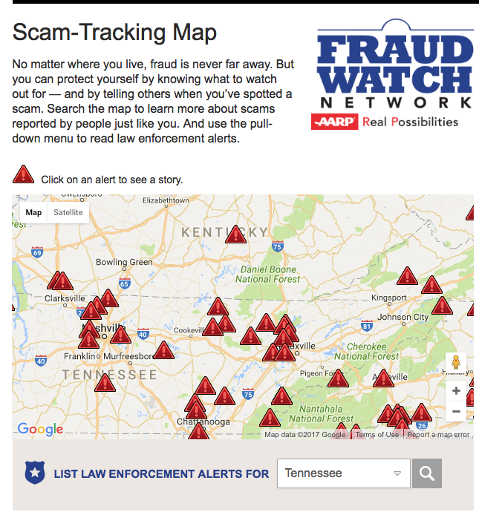
AARP is Fighting for You
AARP is a Watchdog:
Recent Tennessee Reported Scams
Notes:
READ SLIDE

Slide 36
Sign Up for Alerts by e-mail
If you don’t have email call the Fraud Watch phone number (877-908-3360) to be added to either phone or mailed fraud alerts
Thank You
Notes:
Over the years, AARP has worked to educate members about how to protect themselves from fraud. State offices have done scam jams and recruited fraud fighters, E&O has produced anti-fraud materials, our publications cover it regularly, and the Foundation runs a Fraud Fighter program that proactively reaches out to people who fit a victim profile to provide them with ammunition to defend themselves. Why has this work continued, even during times when it was not recognized as a high priority of the organization? Because it resonates with our members, and can provide us with opportunities to engage with people who have turned away from us for any number of reasons.
For this reason, we launched the Fraud Watch Network as a pilot campaign. It’s a pretty basic concept:
Identity theft, investment fraud and scams rob millions of Americans of their hard-earned money.
AARP is launching the Fraud Watch Network to give people the resources to spot and avoid ID theft and fraud so they can protect themselves and their families.

