Slide 1
Home Network
Gary m. smith, usaf (Retired)

Slide 2
What is a home network
A group of computers and/or devices that are interconnected, either physically or wirelessly, to enable the sharing of resources and information.

Slide 3
BENEFITS OF A HOME NETWORK
Sharing Files
Sharing Resources
Shared Internet Access
Gaming

Slide 4
SHARING FILES
Network users find file sharing to be one of the biggest conveniences.
Swap files between computers.
Access other computers from your own system.
Directories and files appear as if they were on your own system.

Slide 5
SHARING RESOURCES
All computers can access devices that are connected to the network.
Printer(s)/Scanner(s)
Smart TV(s)
Storage devices
Smart Devices (phones/tablets)

Slide 6
Shared Internet access
The most common reason for a home network
One internet account will service all computers in the house.
Every member of the family can use the connection simultaneously.

Slide 7
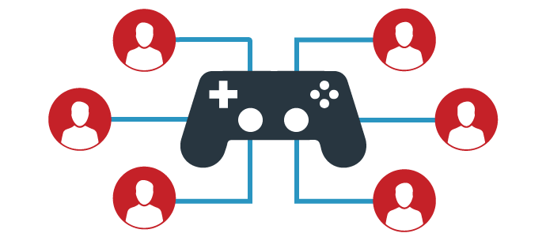
Gaming
Multiple players can compete against each other from different computers in the house.
Send images, audio or video files to other computers on the network.

Slide 8
CONNECTION TECHNOLOGY
There are four main technologies that can implement a home network:
Ethernet (wired connection)
Phone Line
Power-Line (plug in adapters to power lines in your home)
Wireless * most common, easiest and least expensive
Advantages and disadvantages to each; security, speed, convenience and cost are the main issues.

Slide 9
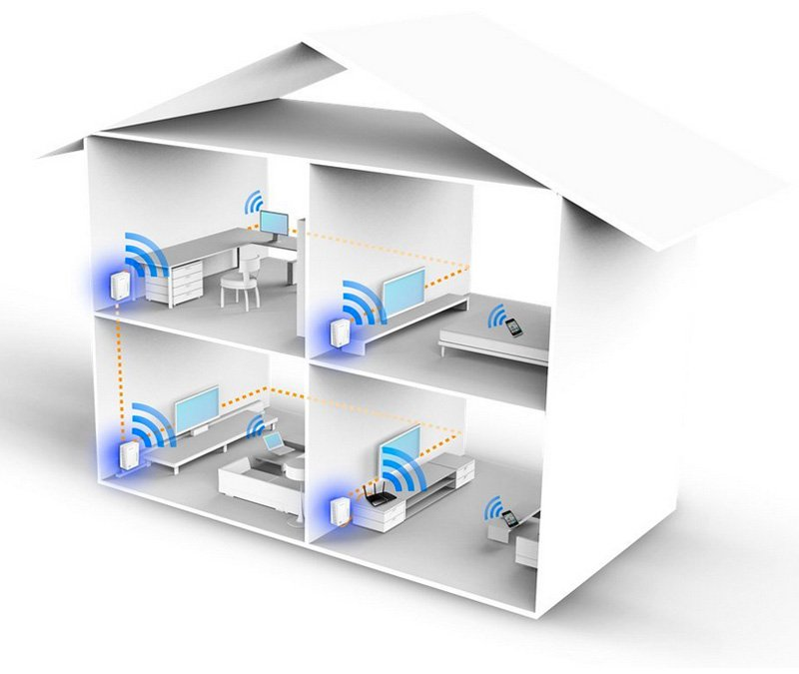
WHAT CAN CONNECT To Wi-Fi NETWORK
Portable computing devices such as a Smart phone, iPhone, iTouch, iPad.
Most portable electronic devices, and virtually all tablets, laptops, net books and smart phones, already have built-in Wi-Fi capabilities.
NOTE: If your computer doesn’t have built-in wireless capabilities, you can easily add Wireless-N capabilities with RangeBooster N® USB Adapter (DWA-140).

Slide 10
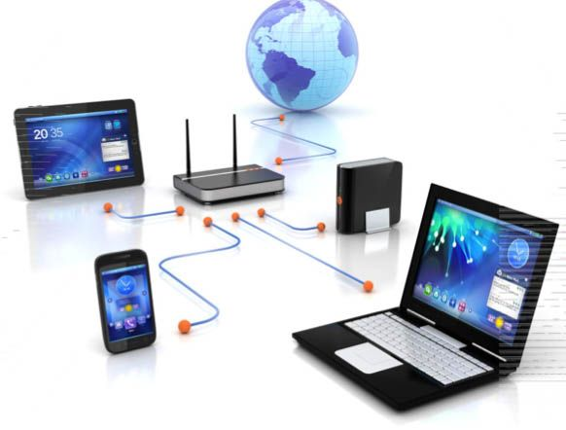
WHAT YOU NEED FOR Wi-Fi NETWORK
Broadband Internet connection provided by an Internet Service Provider (ISP).
Internet modem to decode the Internet signal from your ISP’s network.
Wireless router that enables you to share your broadband connection.
NOTE: ISP may provide combined modem/router unit

Slide 11
CONNECTING DEVICES TO Wi-Fi NETWORK
Enable Wi-Fi on your device, “find” your home network, and connect to it.
Refer to your device’s instruction manual for specifics.

Slide 12
SECURITY
Protect your network from unauthorized users, security options include:
Wired Equivalency Privacy (WEP)
WiFi Protected Access (WPA)
Media Access Control (MAC) address filtering
Your ISP will typically establish this for you when your Wi-Fi is installed.
NOTE: WEP can be broken into very easily

Slide 13
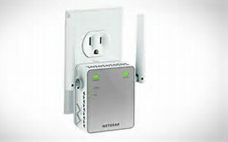
Wi-Fi RANGE EXTENDER
Signals from a wireless router extend about 100 feet in all directions
Walls, microwaves, phones etc., can interrupt the signal.
Boost Wi-Fi signal to eliminate dead zones with a range extender.
$19 to $89
Refer to product’s instruction manual for set-up

Slide 14
WINDOWS 10 - HOMEGROUP
A simpler way of networking, a Homegroup lets every Windows PC in the house share music, photos, movies, and the household printer.
Set up a Homegroup, and Windows automatically begins sharing.
Homegroup strategically leaves out the folder you probably don‘t want to share, your Documents folder.
Homegroup also works with Windows 7, 8, and 8.1
Homegroup doesn‘t work with Vista or Windows XP.

Slide 15
how to set up a new Homegroup
Right-click the Start button (Windows icon, bottom left of your screen) and choose Control Panel from the pop-up menu.
Click the Network and Internet icon.
Click HomeGroup.
NOTE: If you can’t find the Homegroup setting, type “homegroup” into the Settings’ window’s Search box, located in the window’s upper-right corner. When the word HomeGroup appears in the Search Results, click it to open the Homegroup window.

Slide 16
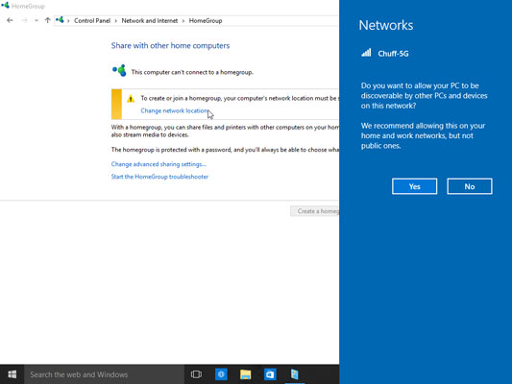
how to set up a new Homegroup
In the Homegroup window, click the “Change Network Location link”
Click the “Yes” button in the pane that appears on the right.
When you first connect to a wireless network, Windows assumes you don’t want anybody accessing your computer, so it defaults your PC to “undiscoverable.” Choosing “Yes,” shown here, tells Windows that you’re on a private network where you want to share things like files and printers and this makes your computer discoverable on the network.

Slide 17
how to set up a new Homegroup
If you’re asked to change the network privacy settings on your computer, be sure to choose Private rather than Public.
Choose the items you’d like to share, click Next.
Select the folders you want to share with your Homegroup.
To share an item, choose Share from its adjacent drop-down menu.
To keep items private, choose Not Shared.
Note: Sharing a folder simply lets other people access that folder’s files to view the pictures or watch a video, for example. They cannot change, delete, create nor place any files in your folder.

Slide 18
how to set up a new Homegroup
Take note of the password listed at the closing screen.
You will need to enter that same password into each computer you want to include in your Homegroup.

Slide 19
JOINING A Homegroup
Leave your computer turned on and follow these same steps on your other computers and select options to join the Homegroup (you’ve just created).
Go to Control Panel.
Click the Network and Internet icon.
Click HomeGroup Join Now button.
Enter the Homegroup password
When you’re through with these steps, you’ve created or joined a Homegroup that’s accessible from every Windows PC on your network. You’ve also set up your PC to allow its Music, Photos, and Videos folders to be shared.

Slide 20
Homegroup PASSWORD
If you lose or forget your homegroup password, simply go to the computer where you created the homegroup. Go to control panel, then homegroup. The settings page will appear and you can view the password (or change it if you like)

Slide 21
Homegroup NOTES
Homegroup is an easy way to create a home network where all your Windows computers can share files and resources.
Homegroup won’t allow you to share with iPads, or smartphones.
To share files between these devices, use the OneDrive app.
For help with OneDrive, download the “Get Started with OneDrive” E-Book from this location: https://support.office.com/en-us/article/eBook-Get-started-with-OneDrive-498739ec-8574-4439-9945-660a273966fa?ui=en-US&rs=en-US&ad=US

Slide 22
QUESTIONS

Slide 23
RESOURCES
https://support.microsoft.com/en-us/help/17145/windows-homegroup-from-start-to-finish
http://www.wikihow.com/Create-a-Home-Network
https://support.hp.com/us-en/document/c03314609/
http://www.networkworld.com/article/2167574/small-business/smb-10-biggest-home-networking-mistakes-and-how-to-fix-them.html

